Slide 1

Rawi&Yuan_Presentation about the Zoo
Her is our presentation PowerPoint about the zoo
Date that I made this 6-6-2025

Slide 2


Content page
1 Start page
2 Content page
3 History of zoos
4 Zoos now
5 Critic on zoos
6 Future of zoos
7 Examples for future zoos
8 Link to site
9 Are their questions

Slide 3
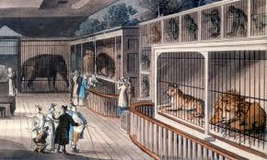
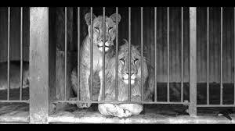
History of zoos
Entertaiment for rich people
Might showing
No attention for animals
Small cages

Slide 4
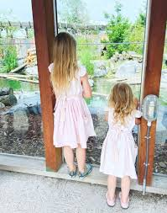

Zoos of now
Education for old and young
Protection for endangered animals
Breeding programs
Natural residence with more space
Working together with nature organisations

Slide 5
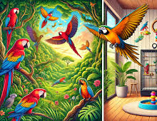
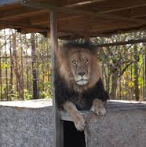
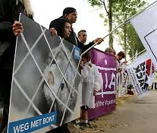
Critic on zoos
Too small residence
Not natural enough residence
Wild animals belong free
Not all the zoos al animal friendly
Breeding programs are not every time effective

Slide 6
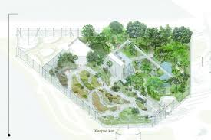
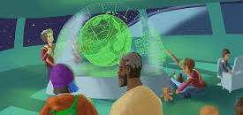
Future of zoos
More space and natural residence
Virtual reality
Only endangered animals
Work together with natural companies
Durable and environment design

Slide 7
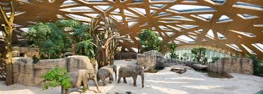
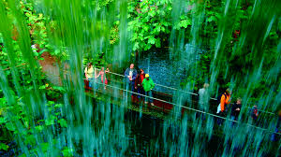
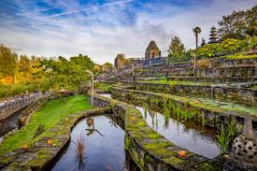
Examples for future zoos
Zoo Zürich – natural environment for each continent
Burgers’ Zoo – forged rainforest and ocean
Pairi Daiza – nature saving

Slide 8


Link to site
Zoo po site
http://127.0.0.1:3000/Po.Html

Slide 9

Are their questions

